Slide 1

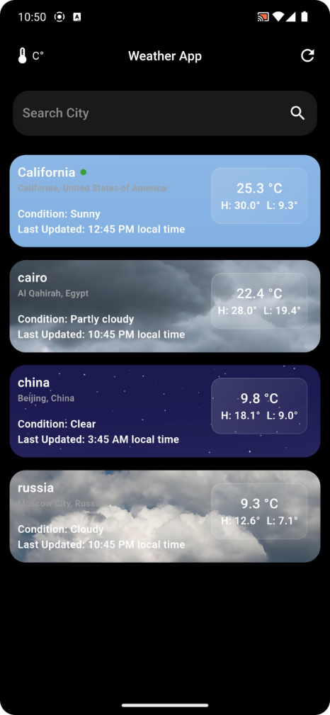

Weather Application
Welcome to our presentation on the development of a weather app! We will explore the key components, features, and challenges of creating a user-friendly and informative weather application.
Mahmoud ELDemerdash
Nada Wahba
Toka Abdelfatah
Mohamed Haddad
Mahmoud Mohamed

Slide 2
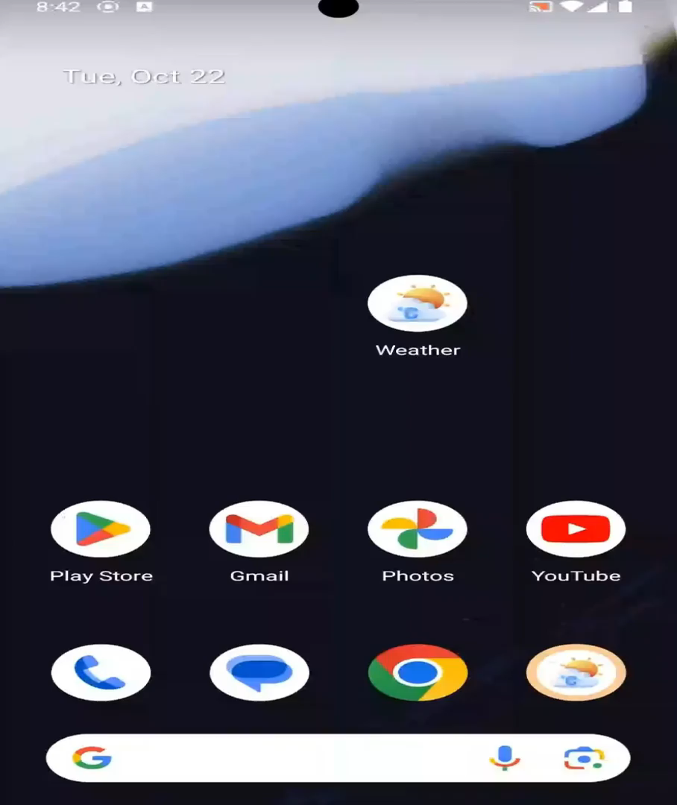
Weather Application
Welcome to our presentation on the development of a weather app! We will explore the key components, features, and challenges of creating a user-friendly and informative weather application.
Mahmoud ELDemerdash
Nada Wahba
Toka Abdelfatah
Mohamed Haddad
Mahmoud Mohamed

Slide 3

The Structure of our Application
Services
Logic
Presentation
This layer provides the core functionality of the application, including weather data retrieval, location handling, notifications, and robust error management. This ensures a smooth and reliable user experience.
This layer utilizes state management solutions like Provider to manage application data and behavior, ensuring a seamless and consistent user experience. It's responsible for three key functions:
This layer is responsible for delivering a visually appealing and intuitive user interface to delight users.
The application has two main screens:
getWeather(String cityName) getUserCity() Notification()
class Failure
fetchWeatherModel(cityName)
fetchUserCity() saveCitiesList()
HomePage() WeatherDetailsPage()

Slide 4

App Services: Location Handling
This service layer focuses on providing accurate and up-to-date location information for the weather app. Here's a breakdown of the key components and functions:
1
Geolocation API
2
Address Lookup
Leveraging the device's GPS to retrieve the user's current location and track their movements.
Translating geographical coordinates into human-readable addresses for improved user experience.
Future<Either<LocationFailure, String?>> getCurrentCity() async {
try {
Position position = await _determinePosition();
List<Placemark> locationDetails =
await placemarkFromCoordinates(position.latitude, position.longitude);
String? city = locationDetails[0].administrativeArea;
return right(city);
} on CurrentLocationException catch (e) {
return left(LocationFailure(e.cause));
} catch (e) {
return left(LocationFailure("Error!!"));
}
}

Slide 5

App Services: API Integration
This service layer focuses on providing accurate and up-to-date location information for the weather app. Here's a breakdown of the key components and functions:
1
Response Parsing
2
Error Handling
Efficiently parsing API responses and transforming the data into a format that can be easily consumed by the app's logic.
Implementing robust error handling mechanisms to gracefully manage API-related failures and provide meaningful feedback to users.
Future<Either<Failure, WeatherModel>> getWeatherForCity(String cityName) async {
try {
Response response = await dio.get(
"$baseUrl/forecast.json?key=$apiKey&q=$cityName&days=3&aqi=yes&alerts=yes");
www.weatherapi.com
WeatherModel weatherModel = WeatherModel.fromJson(response.data);
return right(weatherModel);
} on DioException catch (dioException) {
return left(ServerFailure.fromDioException(dioException));
} catch (e) {
return left(ServerFailure("Unexpected error!!"));
}
}

Slide 6



App Services: Notification Management
Push Notifications
In-App Notifications
Local Notifications
Delivering timely updates and alerts to users, even when the app is not in the foreground.
Providing contextual and interactive notifications within the app to enhance user engagement.
Scheduling reminders and location-based alerts to help users stay informed and on top of important events.

Slide 7

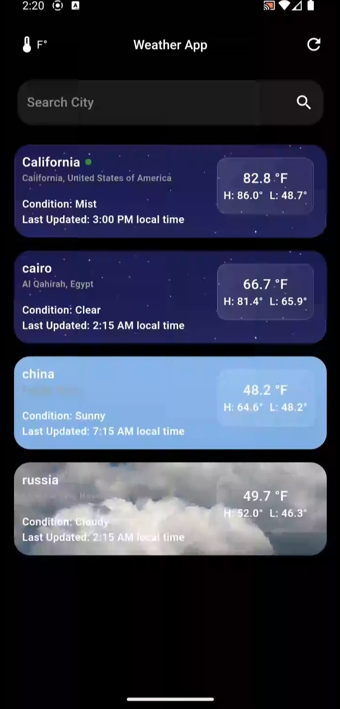


App Services: Error Handling
Implementing robust error handling mechanisms to gracefully manage API-related failures and provide meaningful feedback to users.
abstract class Failure (errMsg)
class ServerFailure extends Failure{
factory ServerFailure.fromDioException(dioException)
}
class Location Failure extends Failure
class CurrentLocationException implements Exception

Slide 8

App Logic: Provider State Management
Experience real-time updates and seamless UI synchronization with Provider's ChangeNotifier, driving a sophisticated architecture that elegantly divides the app's logic and presentation.
Fetch Data from Services
Transfer Data to UI
Call Services to fetch UserCity
String userCity;
Future<void> fetchUserCity(BuildContext context) async {
try {
Either<LocationFailure, String?> cityResult =await LocationService().getCurrentCity();
cityResult.fold(
(city) async {
userCity = city;
notifyListeners();
},
(failure) {Helpers.showSnackBar(context, failure.errMsg);},
);
} catch (e) {
Helpers.showSnackBar(context, 'Unexpected error: $e');
}
}

Slide 9

App Logic: Provider State Management
Experience real-time updates and seamless UI synchronization with Provider's ChangeNotifier, driving a sophisticated architecture that elegantly divides the app's logic and presentation.
Call Api to fetch WeatherModel
Future<WeatherModel?> fetchWeatherModel( String cityName, BuildContext context) async {
WeatherModel? weatherModel;
try {
Either<Failure, WeatherModel> weatherResult = await WeatherService().getWeatherForCity(cityName);
weatherResult.fold(
(weather) {
weatherModel = weather;
},
return weatherModel;
}
(failure) {
Helpers.showSnackBar(context, 'Error fetching weather for $cityName: ${failure.errMsg}');
},
);
} catch (e) {
Helpers.showSnackBar(context, 'Error fetching weather for $cityName');
}

Slide 10

App Logic: Provider State Management
Experience real-time updates and seamless UI synchronization with Provider's ChangeNotifier, driving a sophisticated architecture that elegantly divides the app's logic and presentation.
Save Cities List using shared preferences
List<String> selectedCities ;
addCity(cityName) => selectedCities.add(cityName)
removeCity(index) => selectedCities.removeAt(index)
saveSelectedCities() => prefs.setStringList('selectedCities', selectedCities)
loadSelectedCities() => selectedCities = prefs.getStringList('selectedCities')

Slide 11
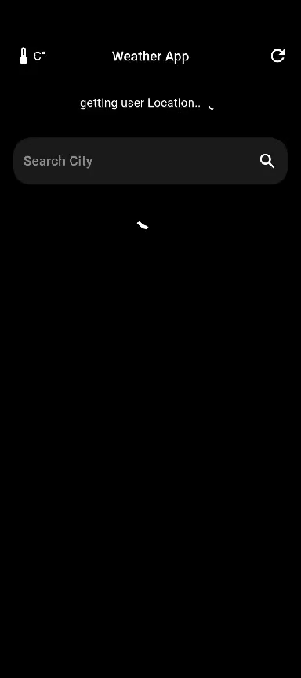

App Presentation: UI Design
Home Screen
A visually appealing and user-friendly home screen that sets the tone for the app's overall experience.
ListView.builder(
itemCount: Provider.of(context). selectedCities. length + 1,
itemBuilder: (context, index) {
if (index == 0) return LiveWeatherCard ();
else return DismissibleCard ( index: index - 1 );
},
)

Slide 12

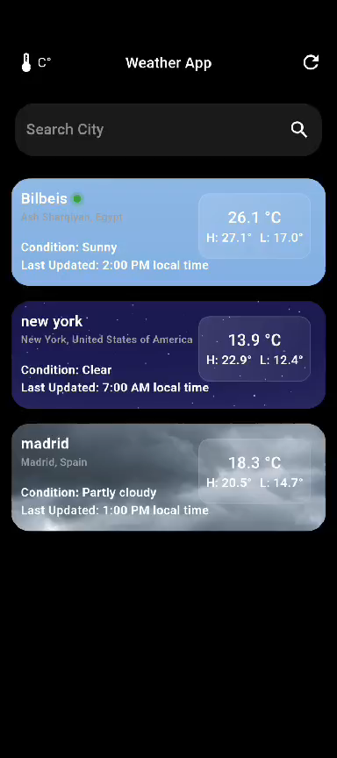
App Presentation: UI Design
Weather Details Screen
The Details screen offers a visually appealing and user-friendly interface, showcasing comprehensive weather information in a way that's easy to understand and navigate.
CityWeatherScreen()

Slide 13
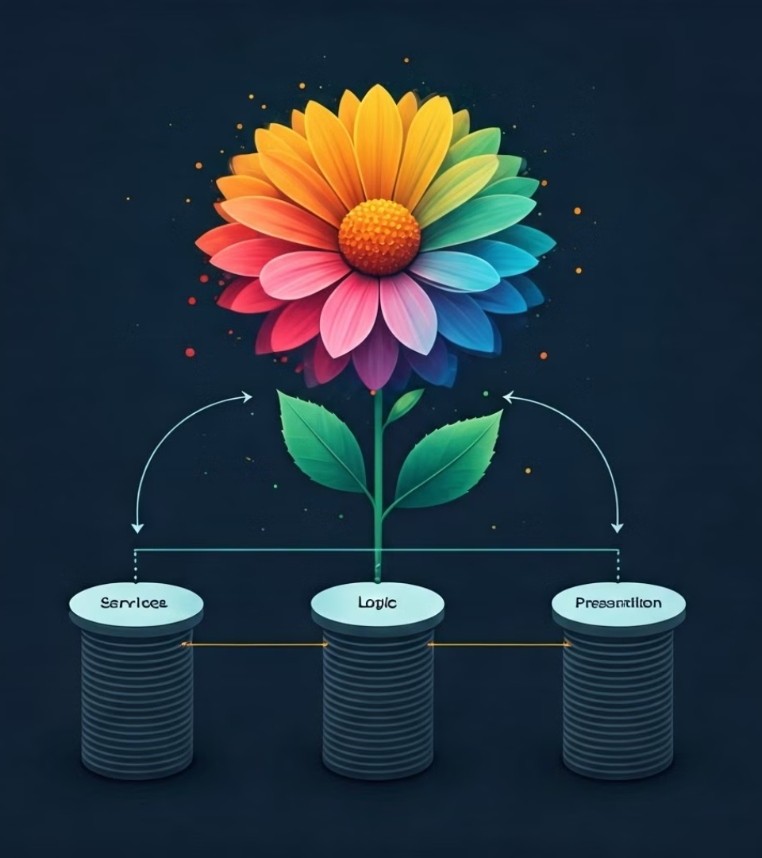
Bringing
It
All
Together

Slide 14
Thank You

